Slide 1
CS152 Section 11
Cache Coherence

Slide 2
Agenda
Snoopy cache coherence protocols
Directory-based protocols

Slide 3
Administrative
PS5 due Monday Apr 26th
Lab5 due Monday May 5th

Slide 4
Cache Coherence vs Memory Consistency
Informally, a memory system is coherent if any read of a given memory location returns the most recently written value
Coherence: What values can be returned for a read
Ordering of operations to the same memory location
Consistency: When a written value will be returned by a read
Ordering of operations to different memory locations

Slide 5
Coherence Invariant #1
Preservation of program order:
A read by a processor P from location X that follows a write by P to X, with no intervening writes to X occurring between the write and read by P, always return the value written by P

Slide 6
Coherence Invariant #2
Eventuality:
A read by a processor from location X that follows a write by another processor to X returns the written value if
The read and write are “sufficiently” separated in time
No other writes to X occur between the read and write

Slide 7
Coherence Invariant #3
Write serialization:
Two writes to the same location by any two processors are seen in the same order by all processors

Slide 8
Cache Coherence Protocols
Snooping: Each cache tracks the status of a cached line by monitoring a broadcast medium (e.g., bus) for transactions
Directory-based: Status of cache line is kept at one site (directory); communicate only with nodes that have copies of the line
Centralized: Typical for SMP
Distributed: Common in distributed shared-memory systems (e.g., SGI Origin)
Snooping and directories can be combined in multi-level memory hierarchies

Slide 9
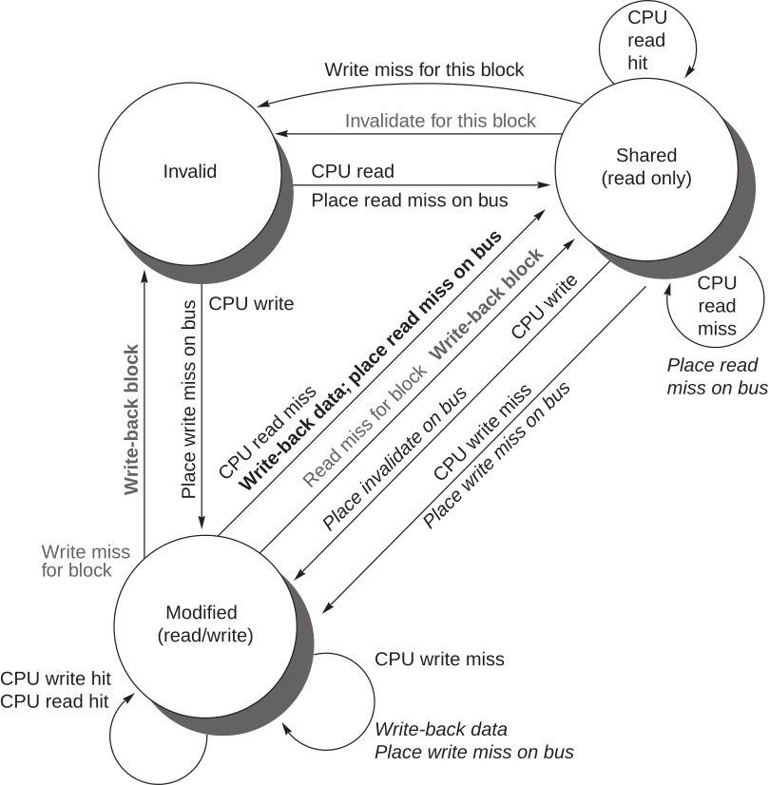
MSI Protocol
If line is in M state, no other cache can have the line; multiple differing copies cannot exist
MESI adds exclusive (E) state: line is resident in one cache still but clean
(Local processor actions shown in black; bus activities shown in gray)

Slide 10
Snooping
Q: A snooping cache coherence protocol requires cores to communicate on a physical bus. True/false?
A: False. Snooping requires a totally ordered broadcast network, but the functionality can be implemented without a shared-wire bus.
Sorin et al. A Primer on Memory Consistency and Cache Coherence (2011)

Slide 11
Snooping
Q: In an MSI snooping protocol, a cache line may be in only one of three coherence states. True/false?
A: False. Transient states are needed if the system does not guarantee atomicity of requests and transactions.
Sorin et al. A Primer on Memory Consistency and Cache Coherence (2011)

Slide 12
MOESI Protocol (Q1)
Extends MESI with a fifth “Owned” state
Allows caches to hold dirty data without invalidating sharers
Only one cache can be in the “Owned” state while the other caches are in “Shared”
Owner is responsible for sending data to other caches requesting the line and must write back the data when it downgrades

Slide 13
For each of the following new state transitions, indicate whether it is a valid transition. If it is a valid transition, explain what triggers it, what conditions must be true (i.e. do other sharers exist?), and what actions must be taken during the transition.
 | Trigger | Condition | Action
I → O
O → I
S → O
O → S
E → O
O → E
M → O
O → M

Slide 14
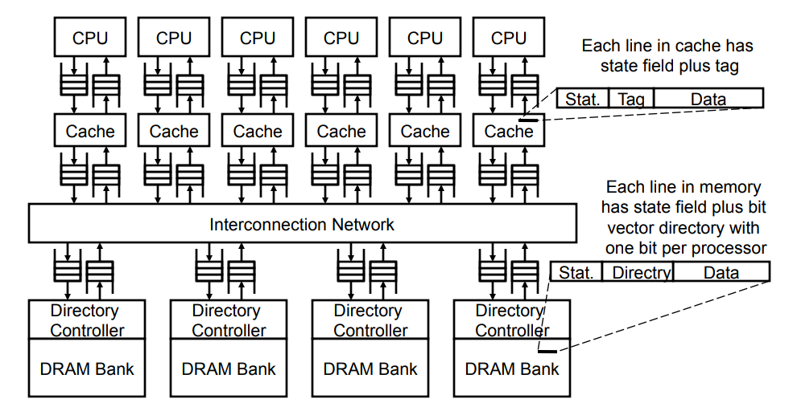
Directory Cache Coherence

Slide 15
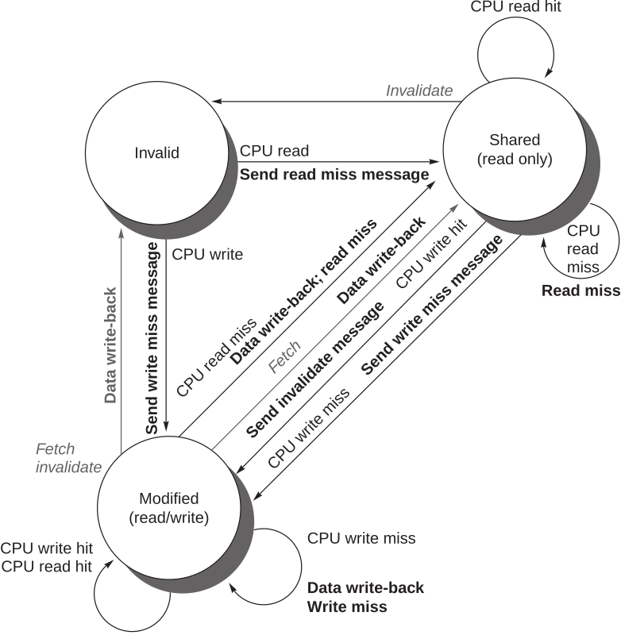
Example Directory Protocol
Cache side
Requests from local processor shown in black
Requests from home directory shown in grey

Slide 16
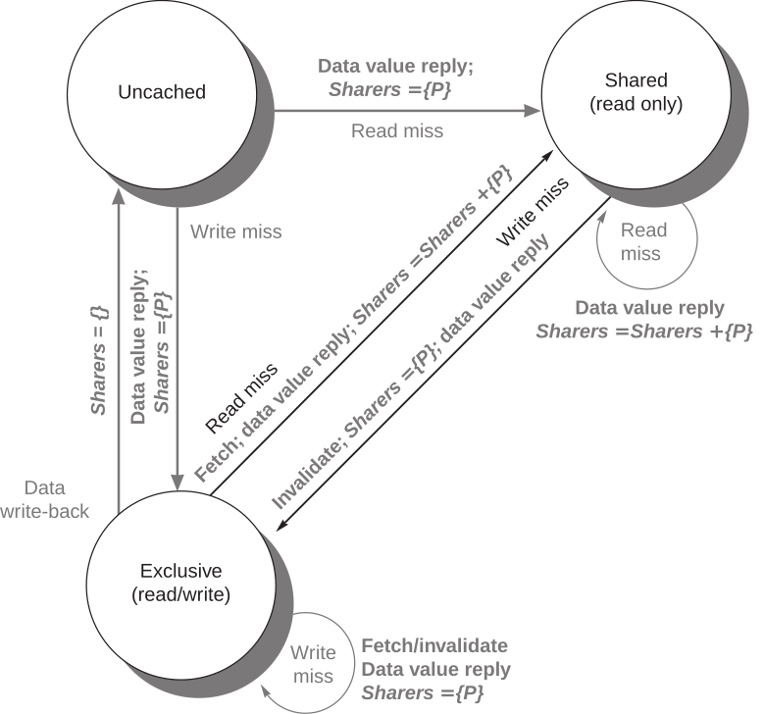
Example Directory Protocol
Directory side
Actions taken by directory shown in bold

Slide 17
Full Bit Vector Scheme (Q2)
In the simplest design, each directory entry contains the state of the cache line and a bit vector with one sharer bit per processor. Assume the directory lines have four states.
How many directory bits are needed per cache line?
For 128 cores with private caches:
For 1024 cores with private caches:

Slide 18
Hierarchical Bit Vector Scheme (Q2)
Storing one bit for each sharer per line not be practical for massively multicore systems
For a 1024-core system with 64B lines, twice as much memory is used for the sharer bits alone than for actual data storage
Aggregate cores into groups and represent each group as a single bit in the bit vector
Invalidations must now be sent to all cores in a group if that group’s bit is set
For a 1024-core system with 64-byte cache lines, how many cores must be in each group to reduce the amount of directory state to 10% the amount of physical memory?

Slide 19
Reducing Storage Overhead (Q2)
One inefficiency of this system is that you must store directory bits for every line in memory, no matter if it is cached or not. How could you reduce this inefficiency?

